Slide 1

Introduction to Machine Learning
Day 1

Slide 2
Agenda
What is Machine Learning and Data Science?
01
Why use Machine Learning?
02
Where is Machine Learning used?
03
Types of Machine Learning
04
Main challenges of Machine Learning
05

Slide 3
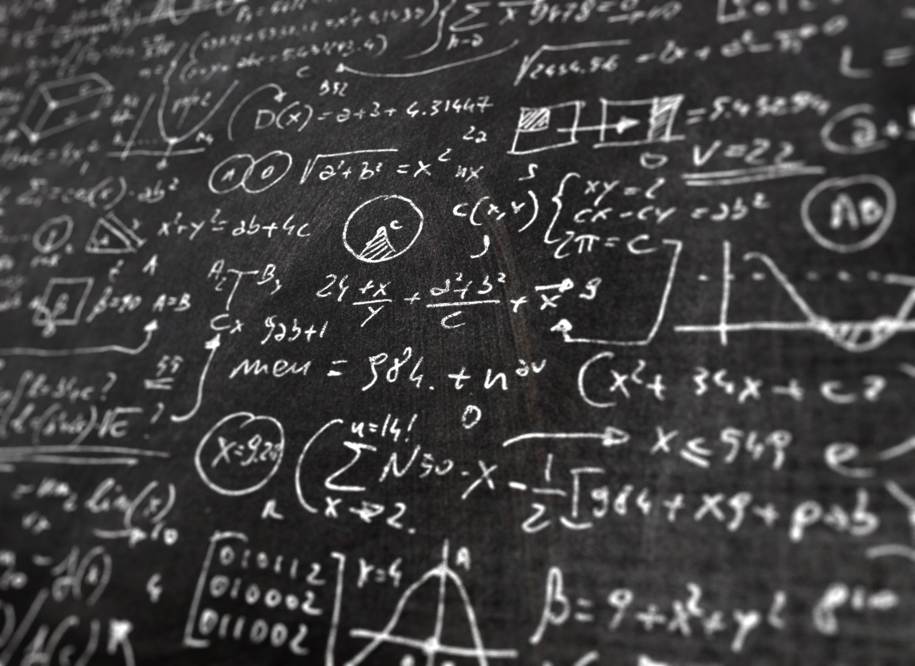
What is Machine Learning and Data Science?

Slide 4
Data Science
Collecting Data
Cleaning the Data
Studying and Analyzing Data
Visualize the Data
Finding Patterns in the Data

Slide 5
Machine Learning
It allows algorithms to learn from experience without being programmed
Machine Learning is the science (and art) of programming computers so they can learn from data.
Your spam filter is a Machine Learning program that, given examples of spam emails and examples of non-spam emails, can learn to flag spam.

Slide 6
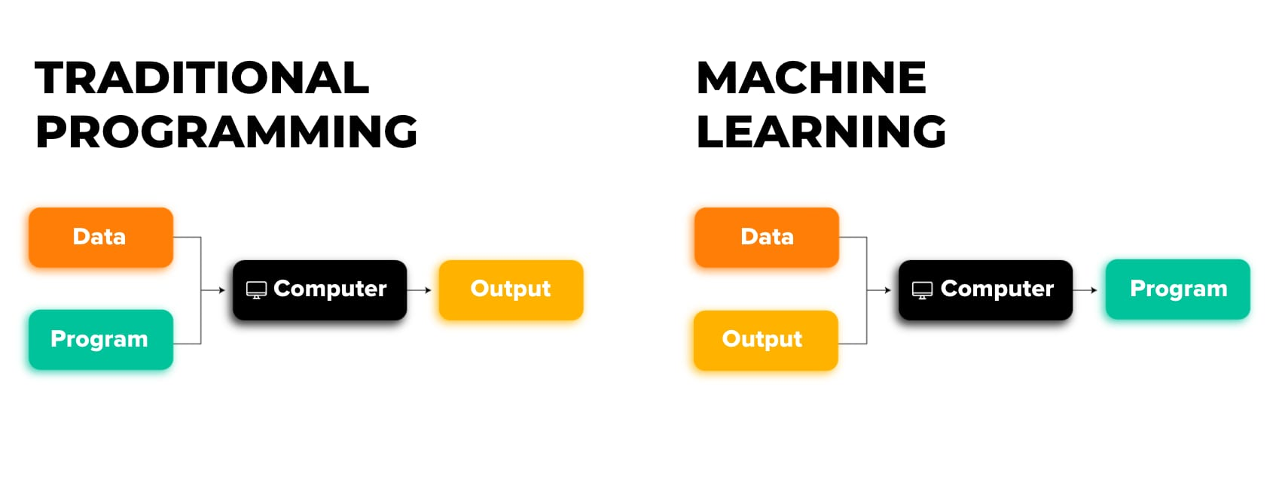
Machine Learning vs. Traditional Programming

Slide 7
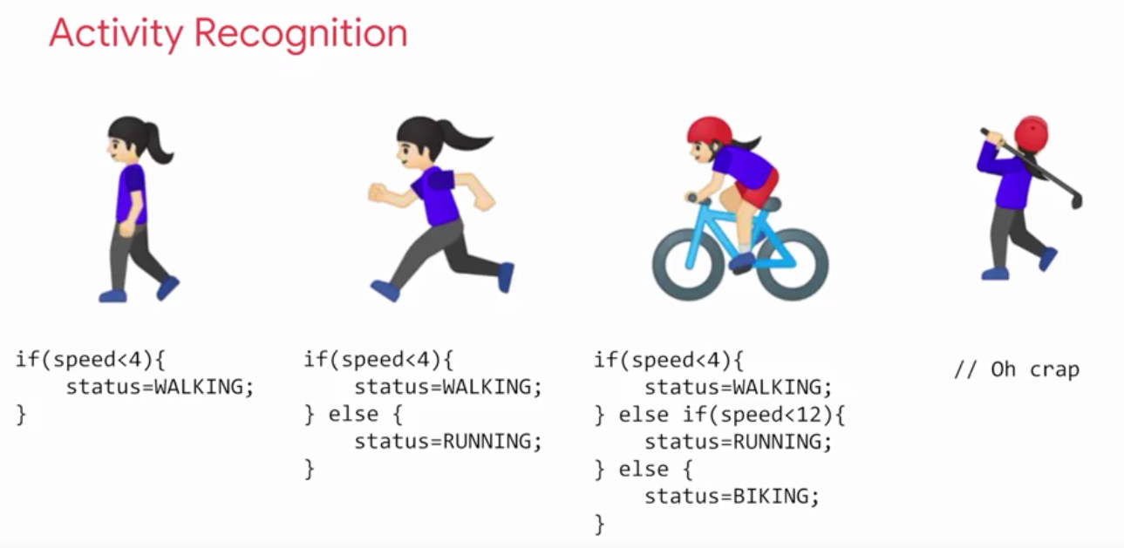
Example of Traditional Programming

Slide 8
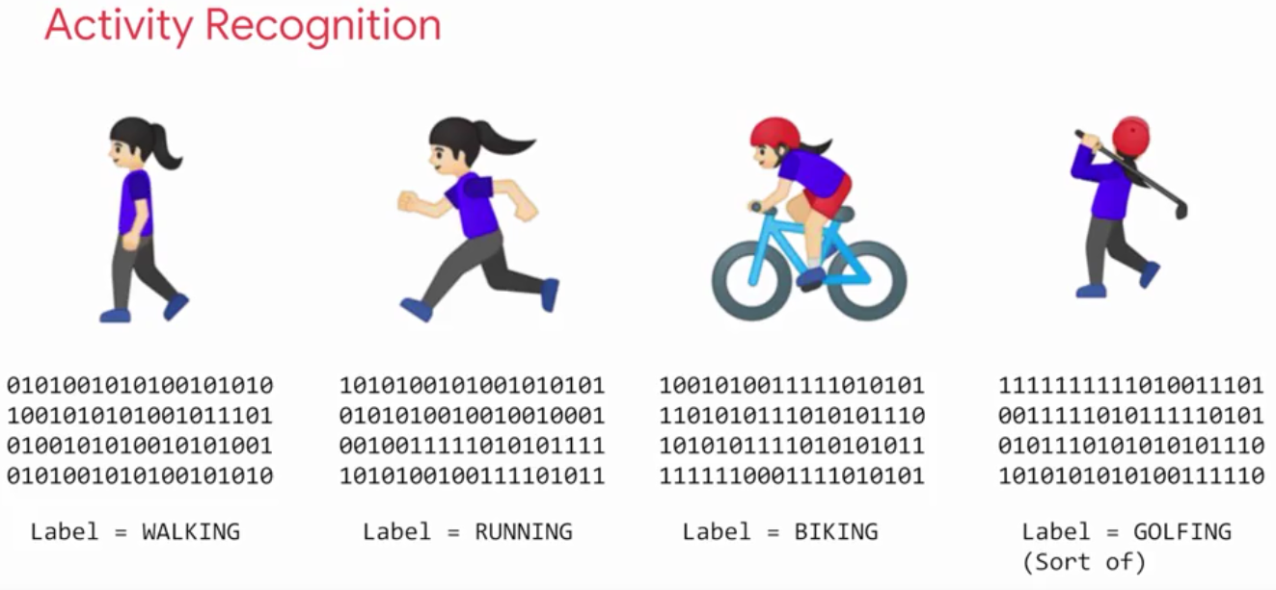
Example of Machine Learning

Slide 9
Why Use Machine Learning?

Slide 10
Creating a Spam Filter (without ML)
Analyze Spam emails and see what they typically look like.
You might notice that some words or phrases like “4U” and “credit card” are common.
You would need to write a detection algorithm for each of the hundreds of patterns you found.
Repeat steps 1, 2 and 3 till the rules are good enough.

Slide 11
Problems with this Approach
Since the problem is difficult, your program will likely become a long list of complex rules—hard to maintain.
What if spammers notice that all their emails containing “4U” are blocked? They might start writing “For U” instead.
If spammers keep working around your spam filter, you will need to keep writing new rules forever.

Slide 12

Creating a Spam Filter (with ML)
Collect examples of Regular and Spam emails.
Train a ML model to classify the emails.
Tweak the model to get highest accuracy.
Automate the above process so that it is updated with latest trends in spam emails.

Slide 13
Advantages of this Approach
A spam filter based on Machine Learning techniques automatically learns which words and phrases are good predictors of spam.
The program is much shorter, easier to maintain, and most likely more accurate.
We can automate this process to retrain the model on the latest data.
This keeps it updated with the latest trends.

Slide 14

ML is Great For
Problems which require a long list of rules. ML simplifies code and reduces stress of maintenance.
Complex problems which do not have any other solution. E.g., Speech recognizing is impossible with traditional programming.
Fluctuating environments: a Machine Learning system can adapt to new data.

Slide 15
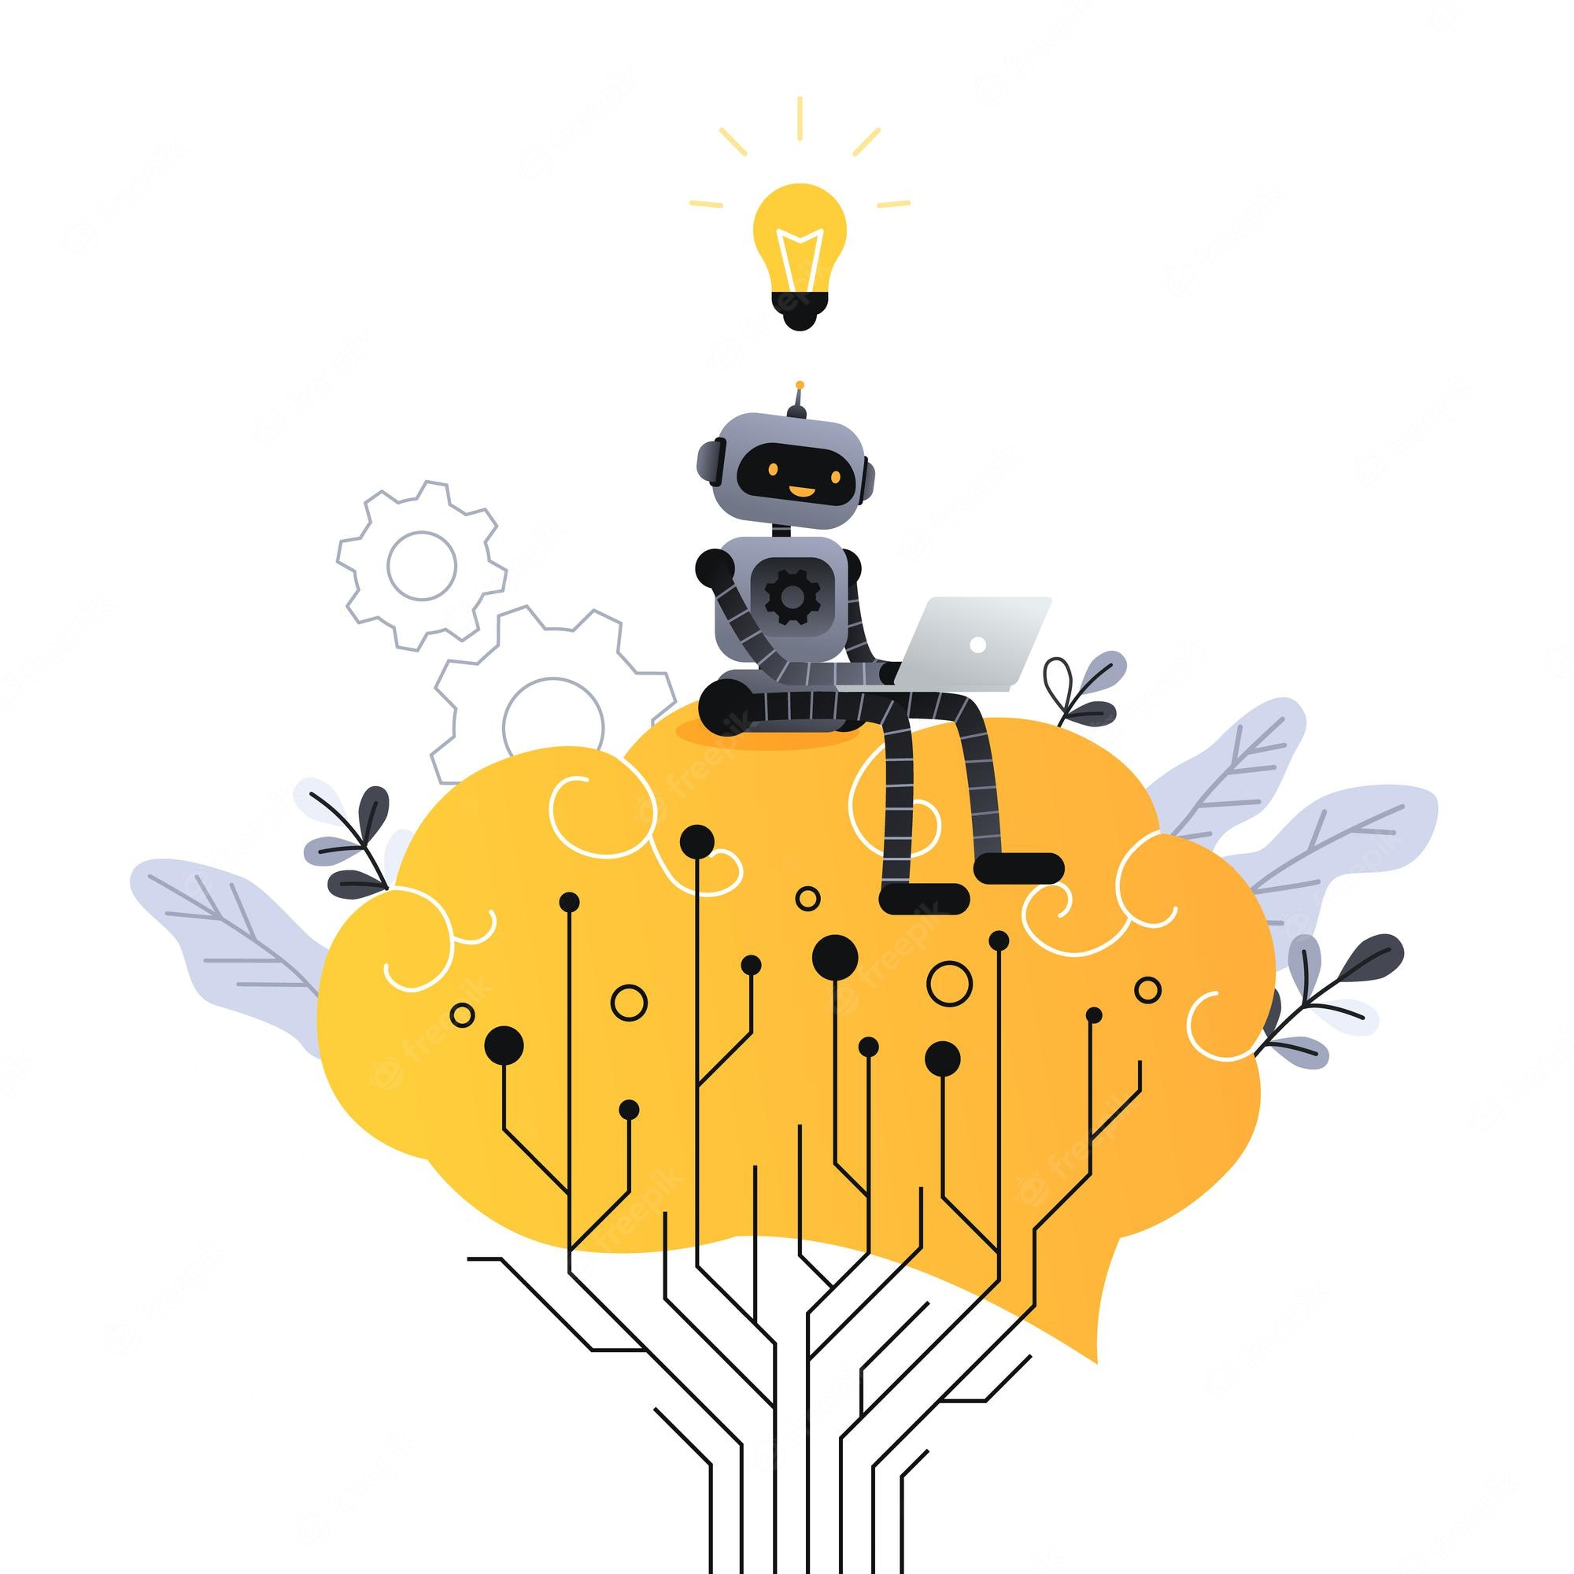
Applications of Machine Learning
Detecting tumors in brain scans
Flagging offensive comments
Summarizing long documents
Creating a chatbot
Forecasting your company’s revenue
Video recommendations on YouTube

Slide 16
Types of Machine Learning

Slide 17
Supervised Machine Learning
In supervised learning, the training set you feed to the algorithm includes the desired solutions, called labels
The task of the algorithm is to predict the labels based on the data.
Most common type of Machine Learning.
There are two types of Supervised Learning algorithms.

Slide 18
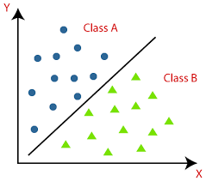
Classification
A typical supervised learning task is classification. The spam filter is a good example of this: it is trained with many example emails along with their class (spam or non-spam), and it must learn how to classify new emails.

Slide 19
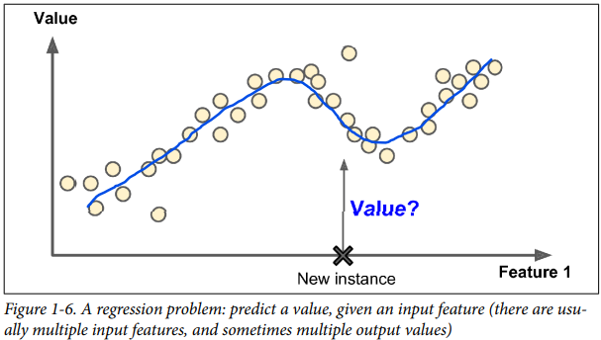
Regression
Another typical task is to predict a target numeric value, such as the price of a car, given a set of features (mileage, age, brand, etc.) called predictors. This sort of task is called regression. To train the system, you need to give it many examples of cars, including both their predictors and their labels (i.e., their prices).

Slide 20
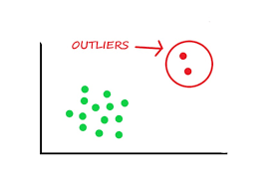
Unsupervised Learning
In unsupervised learning, as you might guess, the training data is unlabeled.
The job of Unsupervised Learning is to find patterns in data.
It is useful in tasks like identifying outliers in our data.

Slide 21
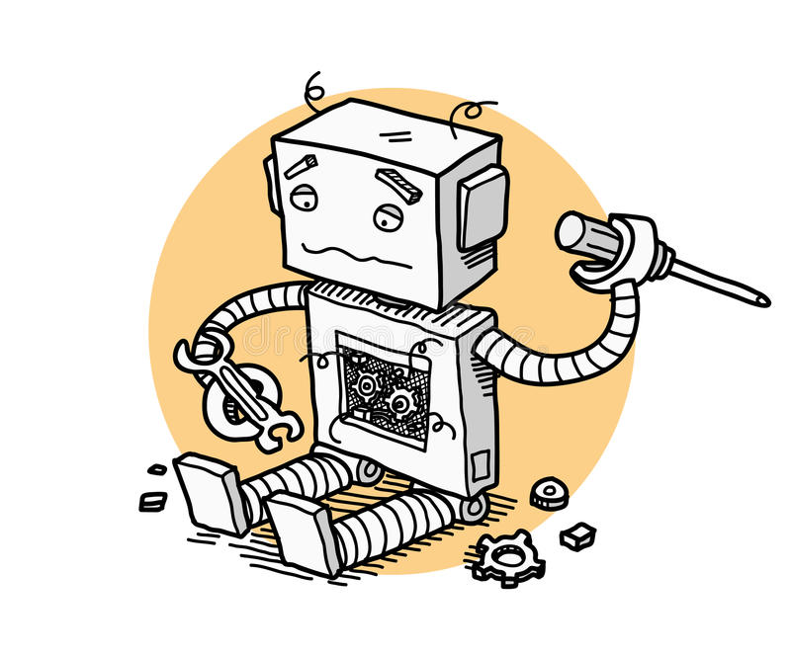
Challenges with Machine Learning

Slide 22
Problems with Machine Learning
Though ML is very useful, there are many challenges associated with creating a good model.
These problems can be categorized into two parts:
Problems with the Data
Problems with the Model

Slide 23

Problems with the Data
Insufficient Quantity of Training Data
Nonrepresentative Training Data
Poor-Quality Data
Irrelevant Features

Slide 24

Problems with the Model
Most Machine Learning models need to tackle 2 main problems:
Overfitting
Underfitting

Slide 25
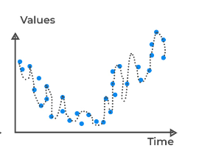
Overfitting
The model performs well on the training data, but it does not generalize well.
Overfitting happens when the model is too complex relative to the amount and noisiness of the training data.
It can be solved by making the model simpler and reducing noise in the data.

Slide 26
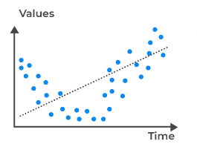
Underfitting
As you might guess, underfitting is the opposite of overfitting.
It occurs when your model is too simple to learn the underlying structure of the data.
Underfitting can be fixed by making the model more complex.

Slide 27
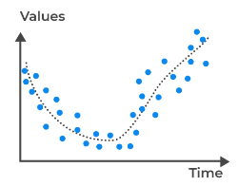
A Perfect Model
A Good Model is one that strikes the balance between underfitting.
It should be simple so that it does not overfit
But it should also be robust, so it captures the complexity if the data.

Slide 28

Testing and Validation

Slide 29
How do we Test Models?
The only way to know how well a model will generalize to new cases is to try it out on new cases.
One way to do that is to put your model in production and monitor how well it performs.
This works well, but if your model is horribly bad, your users will complain—not the best idea

Slide 30
Training and Test Sets
A better option is to split your data into two sets: the training set and the test set.
You train your model using the training set, and you test it using the test set.
The accuracy on the Test set value tells you how well your model will perform on instances it has never seen before
It is common to use 80% of the data for training and 20% for testing.

Slide 31
Conclusion
Machine Learning is about making machines get better at some task by learning from data, instead of having to explicitly code rules.
There are different types of ML systems: Supervised and Unsupervised.
The system will not perform well if your training set is too small, or if the data is not representative, is noisy, or is polluted with irrelevant features.
Lastly, your model needs to be neither too simple (in which case it will underfit) nor too complex (in which case it will overfit).
We should split our data into two sets one to train the model and one to test it on.
Tomorrow we will get our hands dirty and work with some actual code.
Notes:
* Talk about our online environment Jupyter Notebook.

Slide 32
Thank You!

